Slide 1
Differentiation
Product, Quotient & Chain Rule

Slide 2



What you (should) know
Polynomial differentiation
$$y=x^{2}−x+8$$
$$\frac{dy}{dx}=2x−1$$
Use this notation
$$y′=2x−1$$
Avoid this notation
Notes:
I’m about to not follow this advice, and use the y’ notation a LOT.

Slide 3

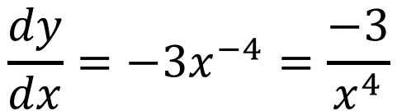
What you (should) know
Inverse polynomial differentiation
$$y=\frac{1}{x^{3}}=x^{−3}$$
$$\frac{dy}{dx}=−3x^{−4}=\frac{−3}{x^{4}}$$

Slide 4
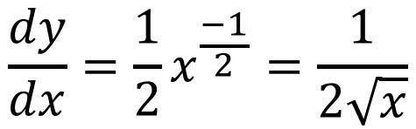


What you (should) know
This result is used so often, it’s worth memorising
Surd differentiation
$$=x^{\frac{1}{2}}$$
$$y=\sqrt{x}$$
$$\frac{dy}{dx}=\frac{1}{2}x^{\frac{−1}{2}}=\frac{1}{2\sqrt{x}}$$

Slide 5
Practice
Delta Workbook
Exercise 6.1
Workbook
This is all assumed knowledge, so no practice

Slide 6
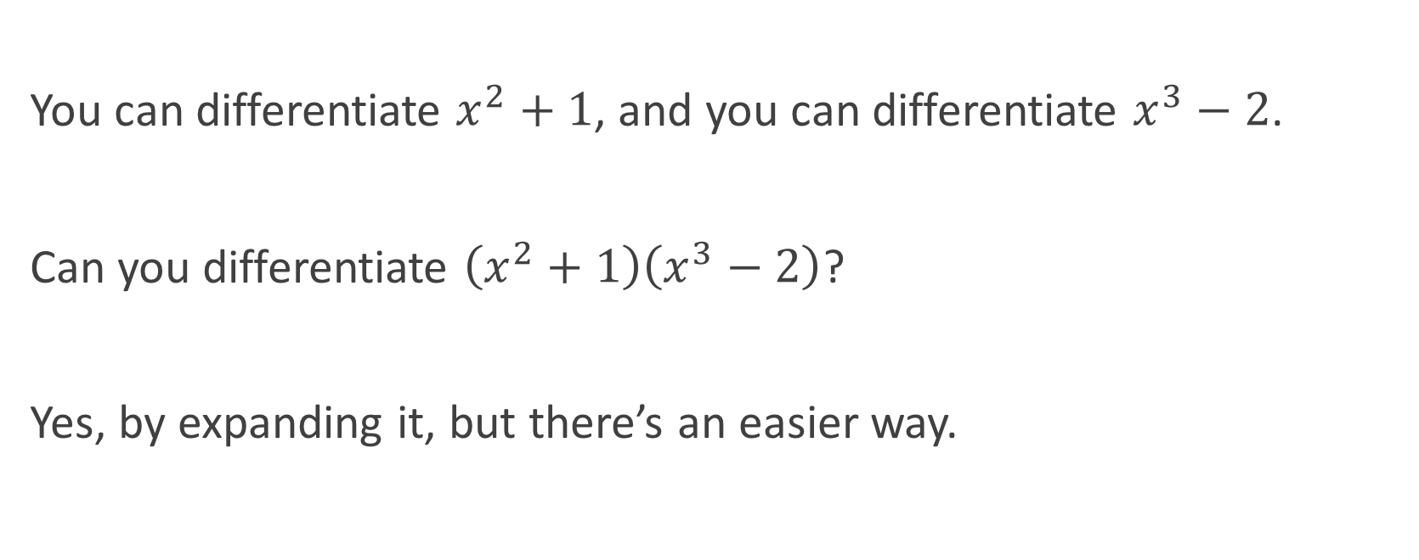
Product Rule
You can differentiate $x^{2}+1$, and you can differentiate $x^{3}−2$.
Can you differentiate $\left(x^{2}+1\right)\left(x^{3}−2\right)$?
Yes, by expanding it, but there’s an easier way.

Slide 7

Product Rule
The product rule states
$${\left(f⋅g\right)}^{′}=f^{′}⋅g+f⋅g′$$
Another way to think about it – differentiate the first term, leave the rest; differentiate the second term, leave the rest, and so on.
For 4 terms, the product rule is
$${\left(stuv\right)}^{′}=s^{′}tuv+st^{′}uv+stu^{′}v+stuv′$$

Slide 8

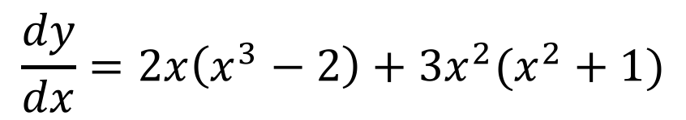
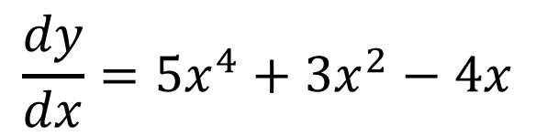





Example 1
Differentiate $y=\left(x^{2}+1\right)\left(x^{3}−2\right)$ without expanding.
$$y=\left(x^{2}+1\right)\left(x^{3}−2\right)$$
$$f=x^{2}+1$$
$$g=x^{3}−2$$
$$f′=2x$$
$$g′={3x}^{2}$$
$$\frac{dy}{dx}=2x\left(x^{3}−2\right)+3x^{2}(x^{2}+1)$$
$$\frac{dy}{dx}=5x^{4}+3x^{2}−4x$$

Slide 9

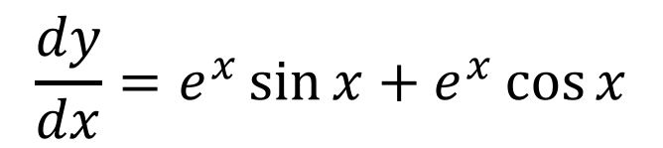
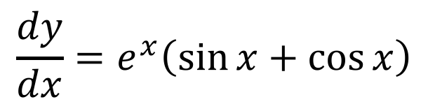





Example 2
Differentiate $e^{x}sin⁡x$
$$y=e^{x}\sin{x}$$
$$f=e^{x}$$
$$g=\sin{x}$$
$$f′=e^{x}$$
$$g′=\cos{x}$$
$$\frac{dy}{dx}=e^{x}\sin{x}+e^{x}\cos{x}$$
$$\frac{dy}{dx}=e^{x}\left(\sin{x}+\cos{x}\right)$$

Slide 10
Quotient Rule
Now we can differentiate products.
What about fractions (quotients)?

Slide 11
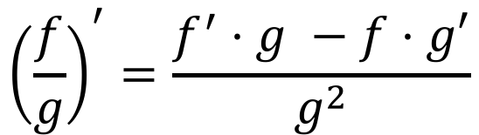
Quotient Rule
The quotient rule states
$${\left(\frac{f}{g}\right)}^{′}=\frac{f^{′}⋅g −f⋅g′}{g^{2}}$$
This rule does not scale very nicely

Slide 12




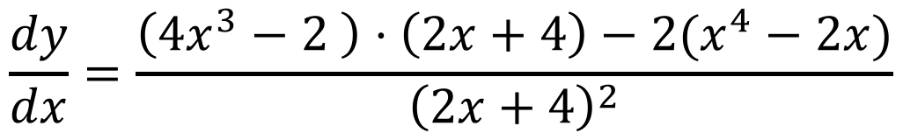
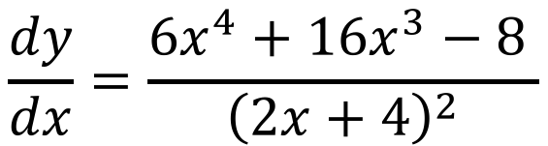

Example 1
Differentiate
$$y=\frac{x^{4}−2x}{2x+4}$$
$$f=x^{4}−2x$$
$$g=2x+4$$
$$f′={4x}^{3}−2$$
$$g′=2$$
$$\frac{dy}{dx}=\frac{\left({4x}^{3}−2 \right)⋅\left(2x+4\right)−2(x^{4}−2x)}{{\left(2x+4\right)}^{2}}$$
$$\frac{dy}{dx}=\frac{6x^{4}+16x^{3}−8 }{{\left(2x+4\right)}^{2}}$$

Slide 13




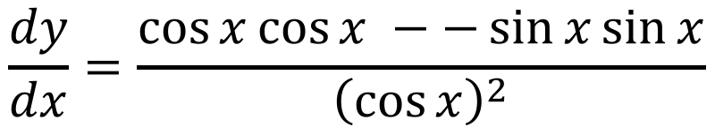
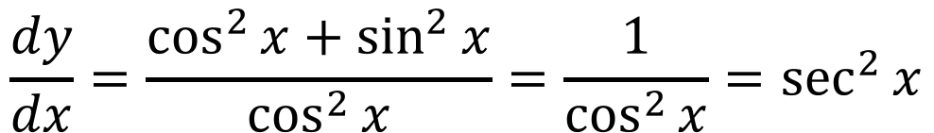
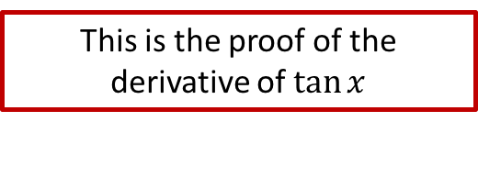

Example 2
This is the proof of the derivative of $tan⁡x$
Differentiate
$$y=\frac{\sin{x}}{\cos{x}}$$
$$f=\sin{x}$$
$$g=\cos{x}$$
$$f′=\cos{x}$$
$$g^{′}=−\sin{x}$$
$$\frac{dy}{dx}=\frac{\cos{x}\cos{x} −−\sin{x}\sin{x}}{{\left(\cos{x}\right)}^{2}}$$
$$\frac{dy}{dx}=\frac{\cos^{2}{x}+\sin^{2}{x}}{\cos^{2}{x}}=\frac{1}{\cos^{2}{x}}=\sec^{2}{x}$$

Slide 14
Chain Rule
Now we know how to handle functions made by multiplying and dividing smaller functions.
What about functions inside functions?

Slide 15
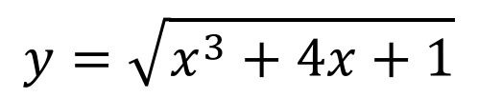




Chain Rule
$$y={\left(4x+2\right)}^{7}$$
$$y=\sqrt{x^{3}+4x+1}$$
$$y=\sin{(\sqrt{x}+π)}$$
$$y=e^{4x}$$
$$y=\ln{(\cos{x})}$$

Slide 16

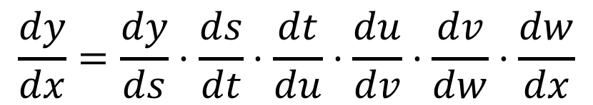
Chain Rule
The chain rule states
$$\frac{dy}{dx}=\frac{dy}{du}⋅\frac{du}{dx}$$
This rule scales excellently, and is actually how it got it’s name
$$\frac{dy}{dx}=\frac{dy}{ds}⋅\frac{ds}{dt}⋅\frac{dt}{du}⋅\frac{du}{dv}⋅\frac{dv}{dw}⋅\frac{dw}{dx}$$
Notes:
Point out that a chain about 3 long is the basis of excellence for Year 13

Slide 17








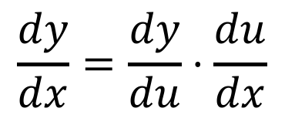


Example 1
Do NOT forget to re-substitute $u$ back into the final equation
Differentiate $y={\left(4x+2\right)}^{7}$
$$y={\left(4x+2\right)}^{7}$$
$$y=u^{7}$$
$$u=4x+2$$
$$\frac{dy}{du}={7u}^{6}$$
$$\frac{du}{dx}=4$$
$$\frac{dy}{dx}=\frac{dy}{du}⋅\frac{du}{dx}$$
$$=7u^{6}⋅4$$
$$=28u^{6}$$
$$=28{(4x+2)}^{6}$$

Slide 18



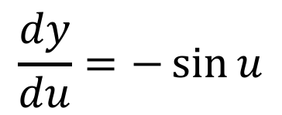

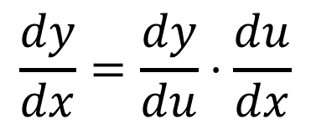




Example 2
Differentiate $y=cos⁡(2x+4)$
$$y=cos⁡(2x+4)$$
$$y=cos⁡u$$
$$u=2x+4$$
$$\frac{dy}{du}=−\sin{u}$$
$$\frac{du}{dx}=2$$
$$\frac{dy}{dx}=\frac{dy}{du}⋅\frac{du}{dx}$$
$$=−sin{u}⋅2$$
$$=−2\sin{u}$$
$$=−2sin⁡(2x+4)$$

Slide 19
Practice
Delta Workbook
Exercises 6.2, 7.1-7.3, 8.1-8.4, 9.1-9.6
Workbook
Pages 23-26

Slide 20
Do Now
Any Questions?
Delta Workbook
Exercises 6.1-6.2, 7.1-7.3, 8.1-8.4, 9.1-9.6
(start with 8.1, 8.2, 9.1)
Workbook
Pages 23-26

Slide 21

This work is licensed under a Creative Commons Attribution-NonCommercial-ShareAlike 4.0 International License.
Aaron Stockdill
2016

